Slide 1
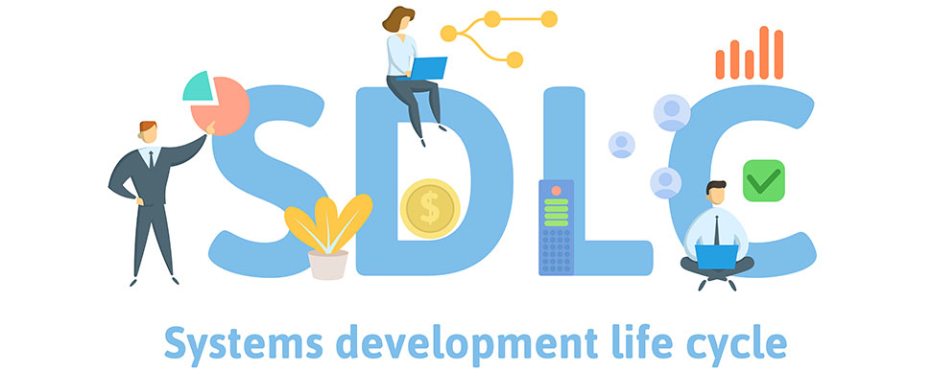

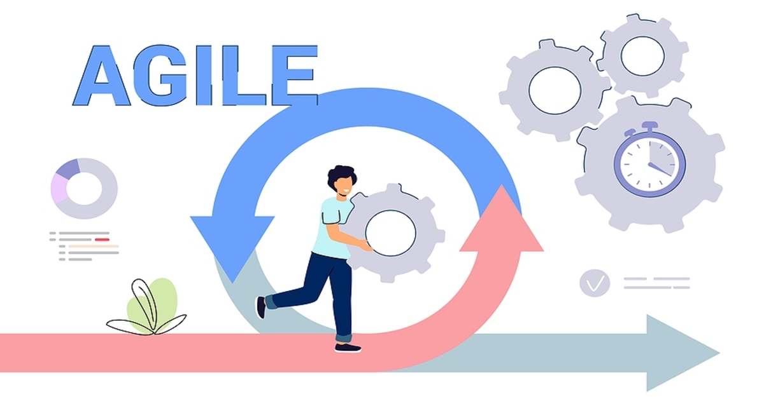
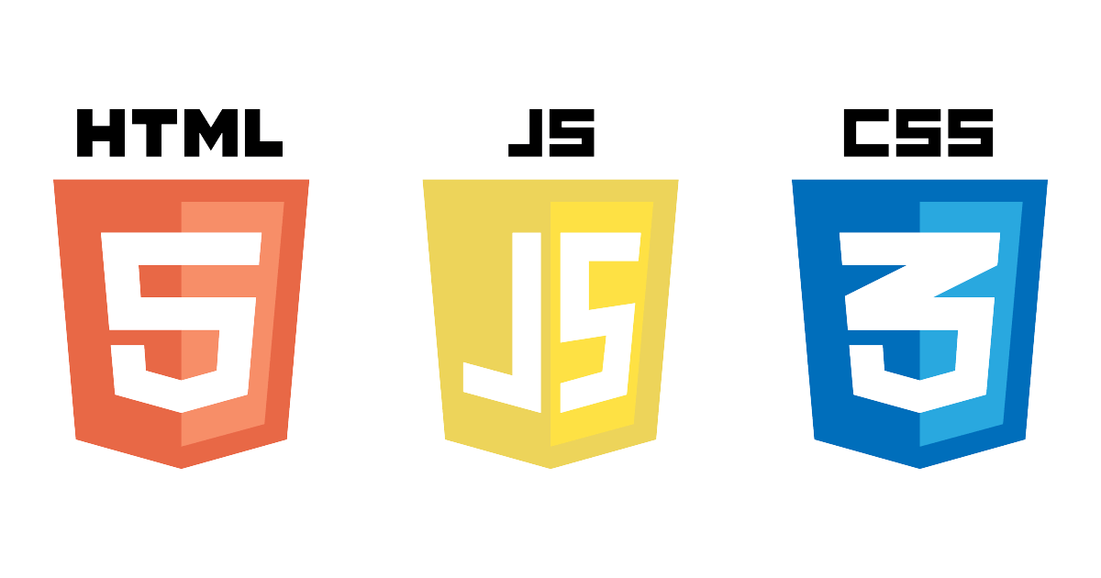
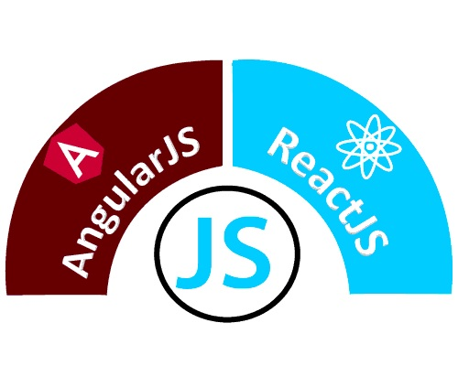
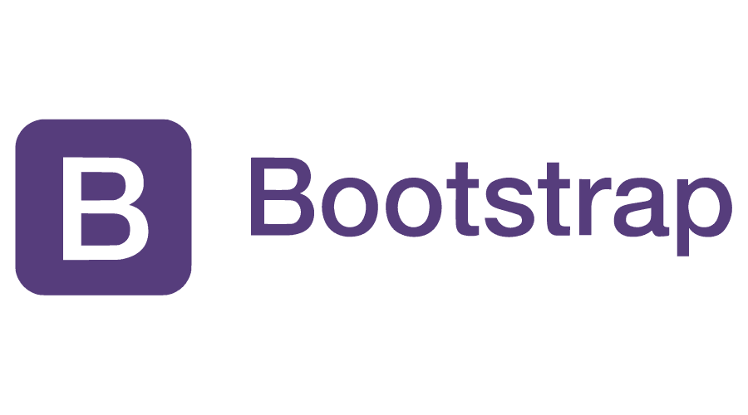
Source Code Management & UI Technologies
Yerram Sneha
Assistant Professor & Corporate Trainer
Computer Science Department
Nalla Malla Reddy Engineering College

Slide 2
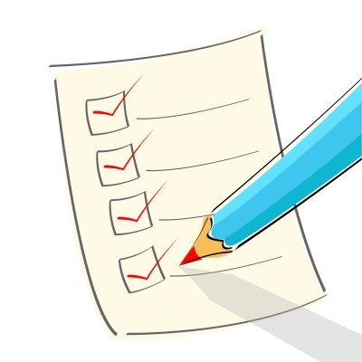
Contents
SE in Industry
SDLC
AGILE
SCRUM
GIT and GitHub
HTML 5, CSS 3
BOOTSTRAP
JAVASCRIPT
ANGULAR
REACT JS
Servlet
JSP

Slide 3

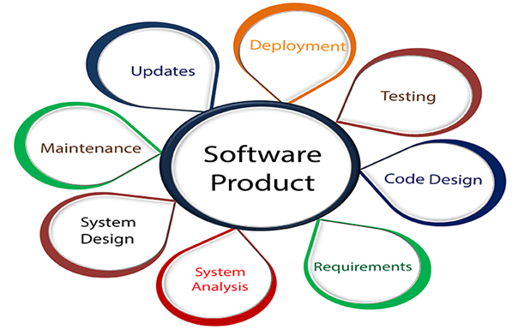
SE IN INDUSTRY
What is Software Engineering?
The term software engineering is the product of two words, software, and engineering.
The software is a collection of integrated programs.
Engineering is the application of scientific and practical knowledge to invent, design, build, maintain, and improve frameworks, processes, etc.

Slide 4

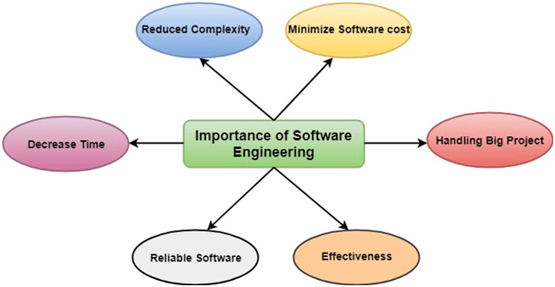
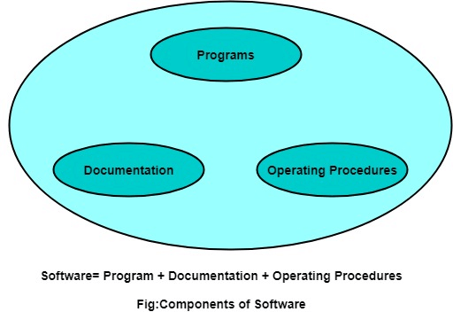
A software process is the set of activities and associated outcome that produce a software product.
Software specifications: The functionality of the software and constraints on its operation must be defined.
Software development: The software to meet the requirement must be produced.
Software validation: The software must be validated to ensure that it does what the customer wants.
Software evolution: The software must evolve to meet changing client needs.

Slide 5
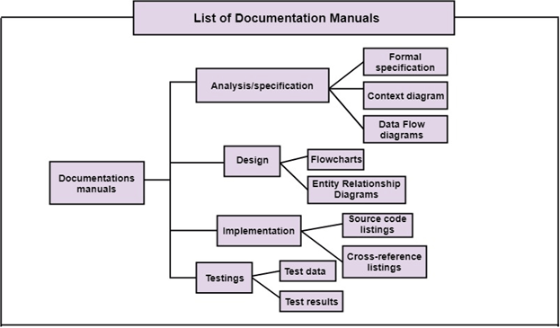
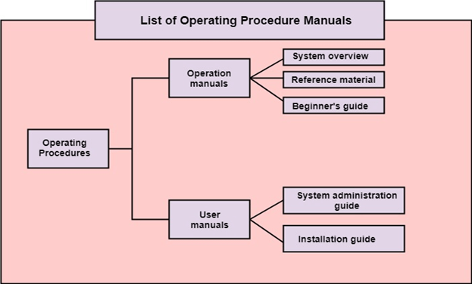
1. Program: Program is a combination of source code & object code.
2. Documentation: Documentation consists of different types of manuals. Examples of documentation manuals are: Data Flow Diagram, Flow Charts, ER diagrams, etc.
3. Operating Procedures: Operating Procedures consist of instructions to set up and use the software system and instructions on how react to the system failure. Example of operating system procedures manuals is: installation guide, Beginner's guide, reference guide, system administration guide, etc.

Slide 6
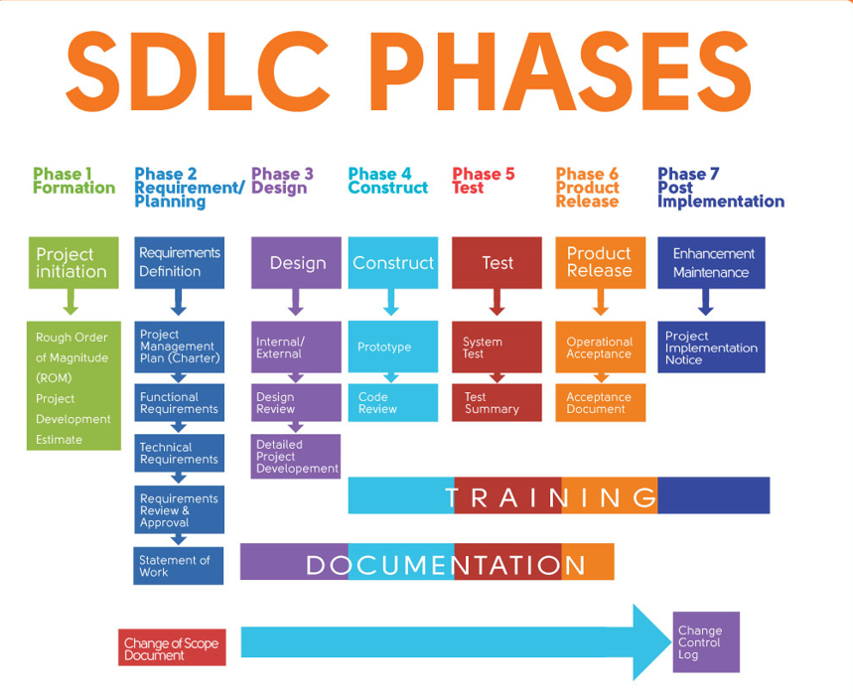
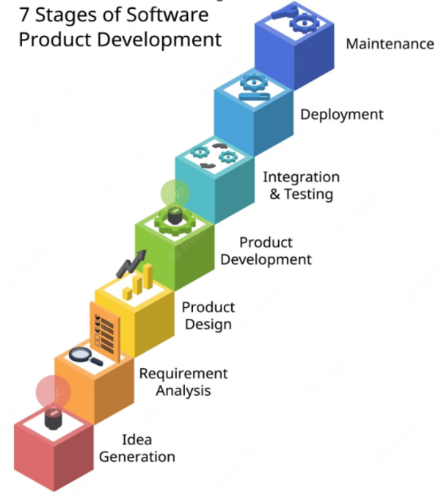

Slide 7
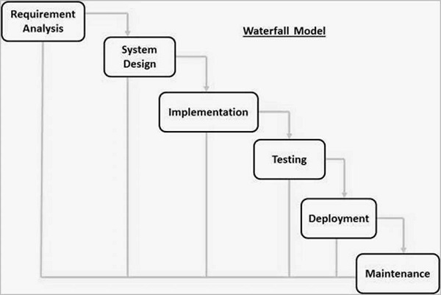
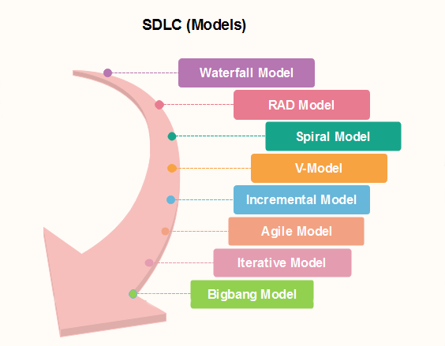
Waterfall Model - Application
Every software developed is different and requires a suitable SDLC approach to be followed based on the internal and external factors. Some situations where the use of Waterfall model is most appropriate are −
Requirements are very well documented, clear and fixed.
Product definition is stable.
Technology is understood and is not dynamic.
There are no ambiguous requirements.
Ample resources with required expertise are available to support the product.
The project is short.
Real-world example: Imagine a construction project where a building is being constructed.

Slide 8
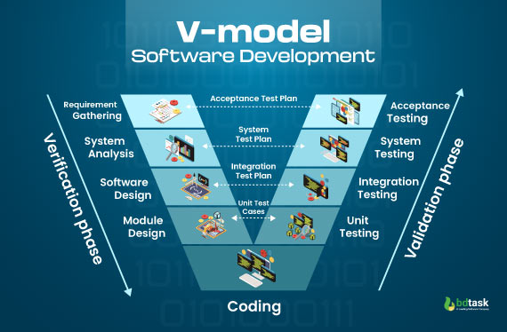
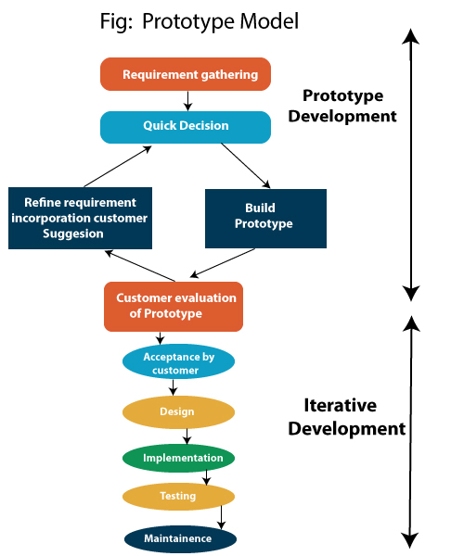
Project managers typically use the V model for small- to medium-sized projects with clear requirements.
Since the V model focuses on planning and testing features instead of creating prototypes, it's important to ensure you fully understand the customer's requirements if you choose to use this model.
The Prototyping Model should be used when the requirements of the product are not clearly understood or are unstable. The prototyping model can also be used if requirements are changing quickly.
Projects initiated from a request for proposals (RFPs), the customer has a very clear documented requirements, Military projects
A real-world example of a prototype model is an e-commerce website

Slide 9
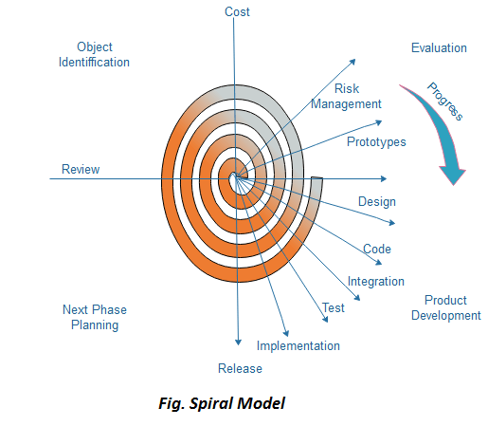
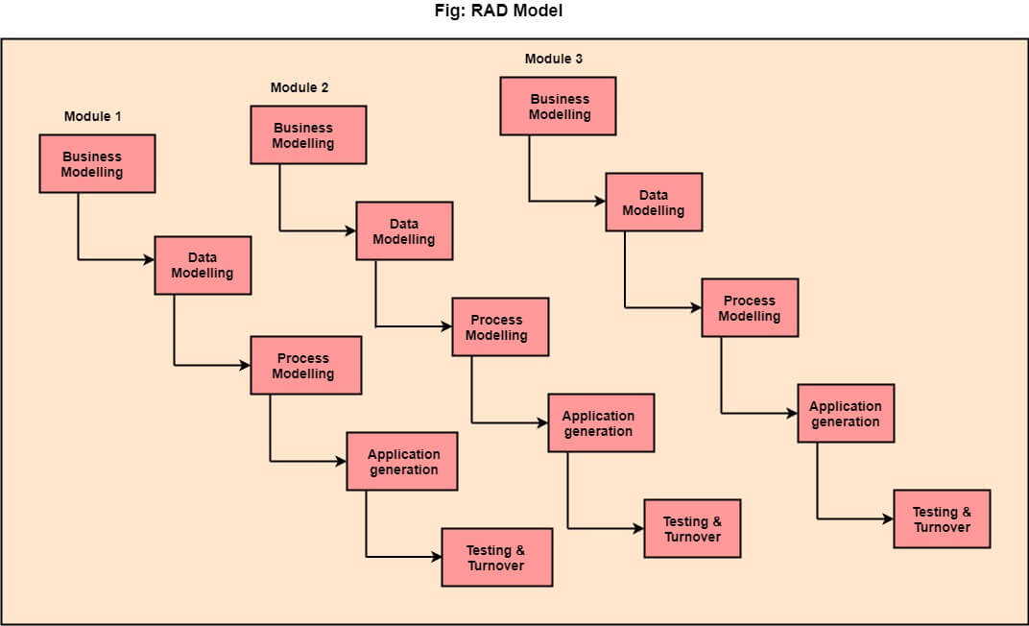
The RAD model is typically suitable just for projects that must be developed and delivered quickly.
The spiral model is often used for complex and large software development projects.
It's also a good option for teams working on high-risk, complex projects.
the popular ride-sharing app, Uber, employed the RAD model to quickly release its initial product, facilitating user feedback and accelerating improvements.
An example product that was built through the Spiral model is NASA's space shuttle program in the 1970s.

Slide 10
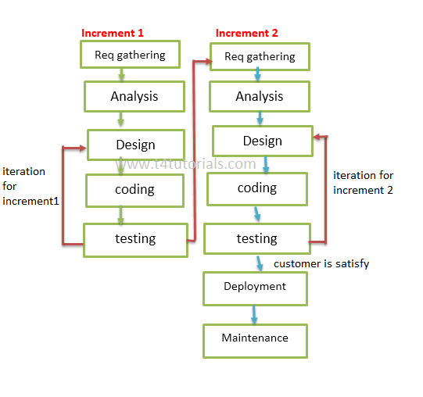
AGILE
The Agile model is a software development process that's incremental and iterative. It defines the number, duration, and scope of each iteration in advance.
When to use the agile model?
When frequent changes are required
When a highly qualified and experienced team is available
When a customer is ready to have a meeting with a software team all the time.
When the project size is large.
Scrum and Sprint
Scrum is an agile project management methodology,
so it is used for software projects that need to be completed within 1 to 4 weeks.
The scrum team guides the sprint team members to complete the project according to customer needs.
The scrum team with the consent of the product owner prepares the product backlog.
A Sprint is an agile project management framework(methodology) that strictly follows the time to complete the project.

Slide 11
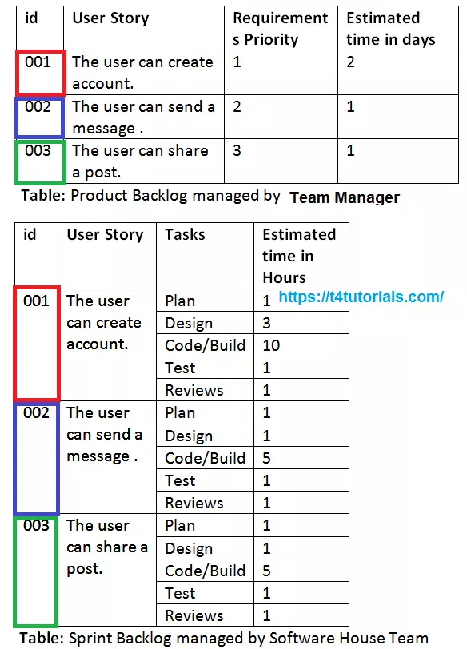
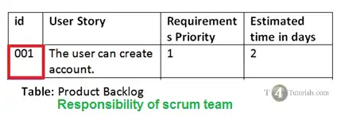
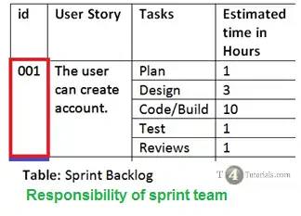
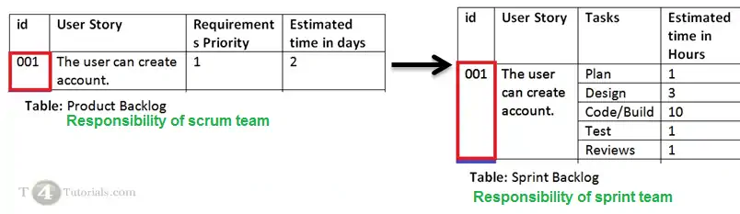
sprint backlog
The sprint backlog is the subset of the product backlog. The team Manager or sometimes the CEO of the software house sets the sprint’s goal for the team. The scrum team picks the user stories from the product backlog fulfilling those goals.
Product backlog
The product backlog can be an information table indicating the priority list of all the requirements given by the user. The team Manager or sometimes the CEO of the software house prepares the product backlog. He prioritizes the requirements based on the customer’s feedback or by keeping in view his personal experience. The functional requirements are represented with user stories.

Slide 12
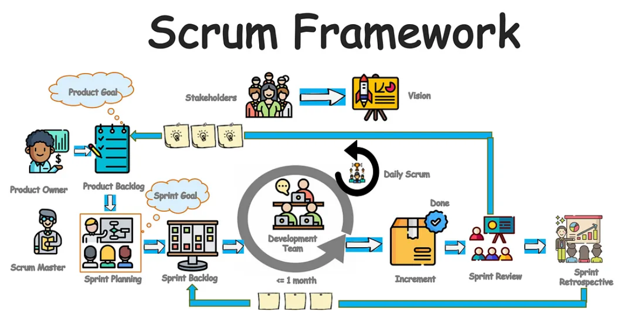
Scrum is a project management framework that helps teams work together to achieve a common goal.

Slide 13
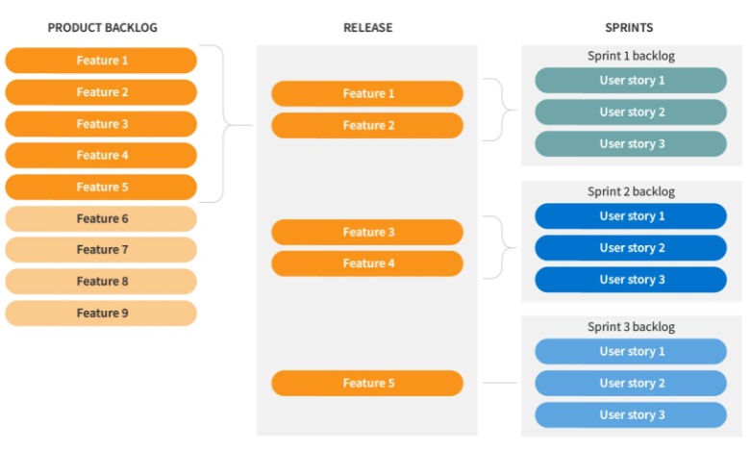
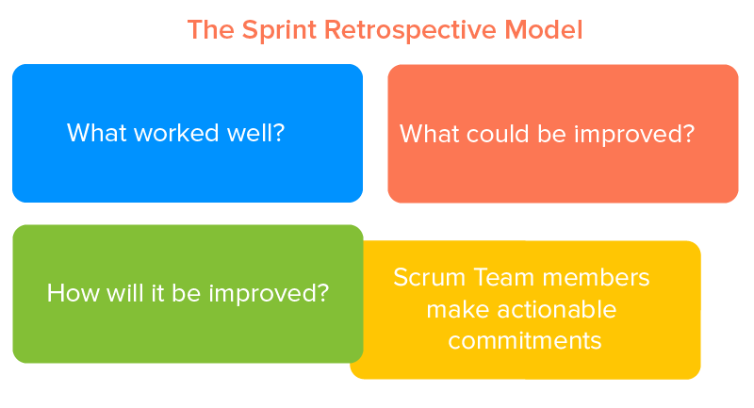

Slide 14
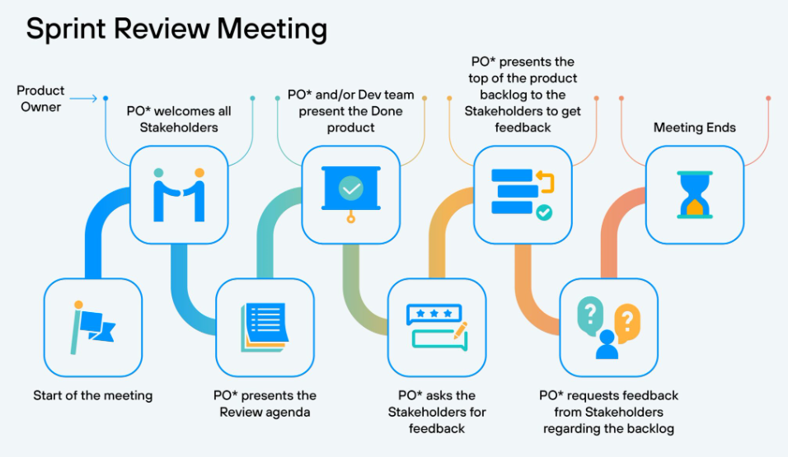

Slide 15


